Slide 1
PERCEPTRON
Solved example
AND classification through perceptron

Slide 2
Perceptron for AND
x1 | X2 | Output
0 | 0 | 0
0 | 1 | 0
1 | 0 | 0
1 | 1 | 1

Slide 3
w1 = 0.3, w2 = -0.2, b = -0.4, LR = 0.2
x1 | x2 | Y_Desired Target | Summation = (x1w1 + x2w2) + b | Activation Function (Y estimated) Step function | bias | w1 | w2 | Status
0 | 0 | 0 | -0.4 | f(-0.4) = 0 | -0.4 | 0.3 | -0.2 | No change
0 | 1 | 0 |  |  | -0.4 | 0.3 | -0.2 | No
1 | 0 | 0 |  |  | -0.4 | 0.3 | -0.2 | No
1 | 1 | 1 | -0.3 | 0 | -0.2 | 0.5 | 0 | change

Slide 4
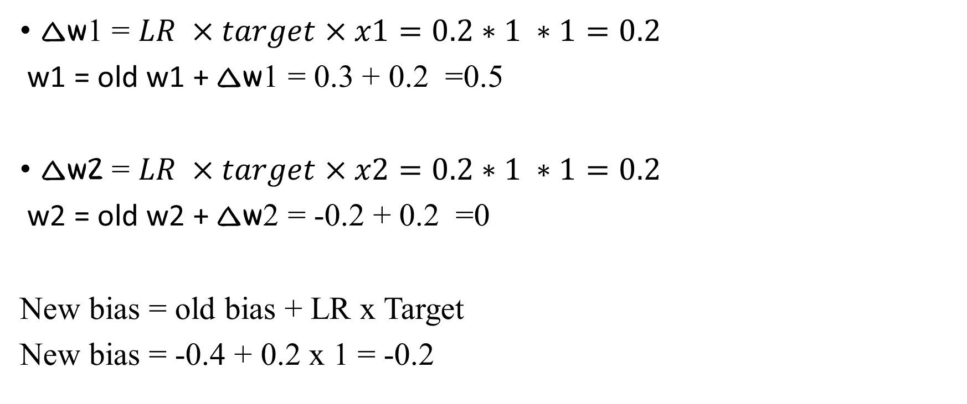
Update weights
∆w1 = $LR ×target×x1=0.2∗1 ∗1=0.2$
w1 = old w1 + ∆w1 = 0.3 + 0.2 =0.5
∆w2 = $LR ×target×x2=0.2∗1 ∗1=0.2$
w2 = old w2 + ∆w2 = -0.2 + 0.2 =0
New bias = old bias + LR x Target
New bias = -0.4 + 0.2 x 1 = -0.2

Slide 5
w1 = 0.5, w2 = 0, b = -0.2, LR = 0.2
x1 | x2 | Y_Desired Target | Summation = (x1w1 + x2w2) + b | Activation Function (Y estimated) Step function | bias | w1 | w2 | Status
0 | 0 | 0 |  |  | -0.2 | 0.5 | 0 | No change
0 | 1 | 0 |  |  | -0.2 | 0.5 | 0 | No change
1 | 0 | 0 |  |  | -0.4 | 0.3 | 0 | Change
1 | 1 | 1 |  |  | -0.2 | 0.5 | 0.2 | Change

